Slide 1

HEART DISEASE PREDICTION
Cantilever AIML Proternship 2025
Team Members :-
Varnit Kolakotla – 23R11A0525
Sreekar Sarma Telakapalli – 23R11A0536
Addepalli Sharan Kumar Raju – 23R11A05U8

Slide 2
Introduction
Heart disease remains one of the leading causes of death worldwide, claiming millions of lives each year. Early detection is critical because it allows for timely medical intervention, lifestyle changes, and significantly improves patient outcomes. However, diagnosing heart disease accurately can be complex and time-consuming, often requiring expert interpretation of multiple clinical parameters.
Our project addresses this challenge by building a machine learning–based prediction system that assists in the early identification of heart disease. Using a dataset of patient medical records, we trained a predictive model that analyzes key indicators such as age, chest pain type, blood pressure, cholesterol levels, and ECG results. We then deployed this model into a user-friendly web application built with Streamlit, allowing users to input medical data and receive an instant prediction on whether they are at risk of heart disease.
This intelligent tool acts as a decision support system—helping doctors, healthcare workers, and individuals make informed decisions and seek medical attention at the right time.

Slide 3



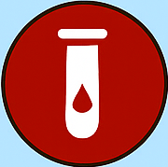


Features used to predict the Heart Disease
AGE
CHEST PAIN TYPES
RESTING BLOOD PRESSURE
The Person’s age, as heart risk increases with age.
Describes the type of chest pain experienced.
Blood pressure in mm Hg at rest, elevated levels may indicate heart stress.
FASTING BLOOD SUGAR
CHOLESTOROL
RESTING ECG
ECG interpretation at rest, helps identify heart disease.
Serum cholestorol in mg/dl.
Indicates if blood sugar > 120 mg/dl after fasting.

Slide 4






Features used to predict the Heart Disease
EXERCISE- INDUCED ANGINA
MAXIMUM HEART RATE
ST DEPRESSION
The highest heart rate achieved during a stress test.
Measure of ST depression; indicates possible ischemia.
Indicates whether the patient experienced chest pain
THALASSEMIA
VESSELS
ST SLOPE
The “slope” of the peak exercise ST segment.
Number of major vessels visible via fluoroscopy.
Type of hereditary blood disorder.

Slide 5
Feature Explanation
Chest Pain Type (cp) Indicates the type of chest pain experienced. There are 4 types:
0: Typical angina (related to decreased blood supply to the heart)
1: Atypical angina (not related to heart stress)
2: Non-anginal pain (not related to heart)
3: Asymptomatic (no pain but possibly heart disease symptoms)
Resting Blood Pressure (trestbps) The resting blood pressure measured in mm Hg when the patient is at rest. High values may indicate hypertension, a key risk factor for heart disease.
Resting Electrocardiographic Results (restecg) Reflects the heart's electrical activity at rest:
0: Normal
1: ST-T wave abnormality (may indicate myocardial ischemia)
2: Left ventricular hypertrophy (thickening of heart wall)
Serum Cholesterol (chol) The cholesterol level in mg/dl. Elevated cholesterol levels can lead to plaque buildup in arteries, increasing the risk of heart attacks.

Slide 6
Feature Explanation
Fasting Blood Sugar (fbs) Indicates whether fasting blood sugar > 120 mg/dl:
1: True (High blood sugar, may indicate diabetes)
0: False High levels are linked to increased risk of cardiovascular issues.
Exercise-Induced Angina (exang) Indicates whether the patient experienced chest pain (angina) during exercise:
1: Yes
0: No Suggests reduced blood flow to the heart under stress.
ST Depression (oldpeak) ST depression induced by exercise relative to rest. Higher values often correlate with greater heart stress or ischemia.
Slope of the ST Segment (slope) Describes the slope of the peak exercise ST segment:
0: Upsloping (normal)
1: Flat (possible abnormality)
2: Downsloping (strongly associated with heart disease)

Slide 7
Feature Explanation
Number of Major Vessels Colored by Fluoroscopy (ca) Indicates how many major coronary arteries are observed to be narrowed (0–3). More vessels with narrowing suggests higher disease risk.
Thalassemia Type (thal) Describes a blood disorder affecting oxygen transport:
1: Fixed defect (permanent damage)
2: Normal
3: Reversible defect (temporary condition) Abnormal thal values can signal issues with heart muscle oxygen supply.

Slide 8
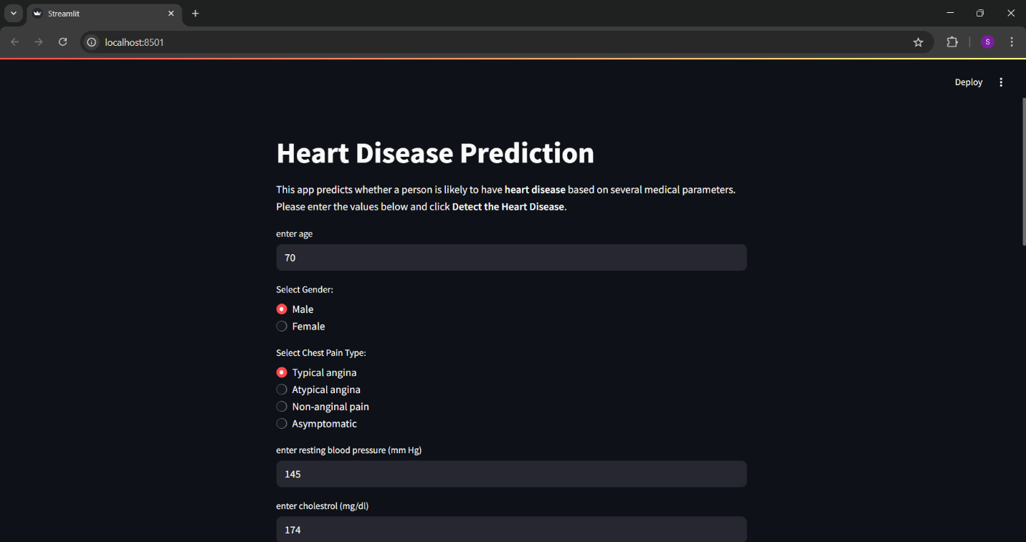
Output for a person with no heart disease

Slide 9
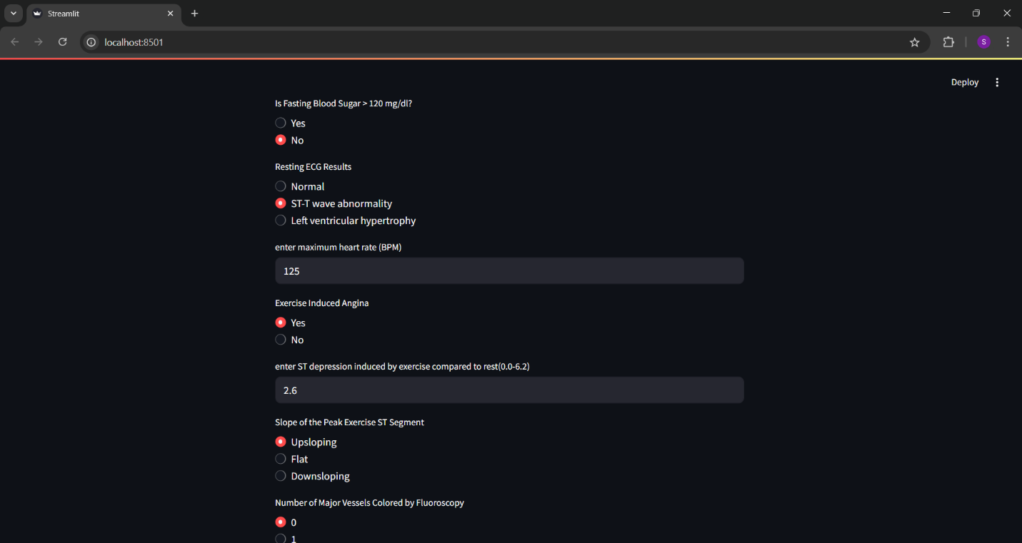
Output for a person with no heart disease

Slide 10
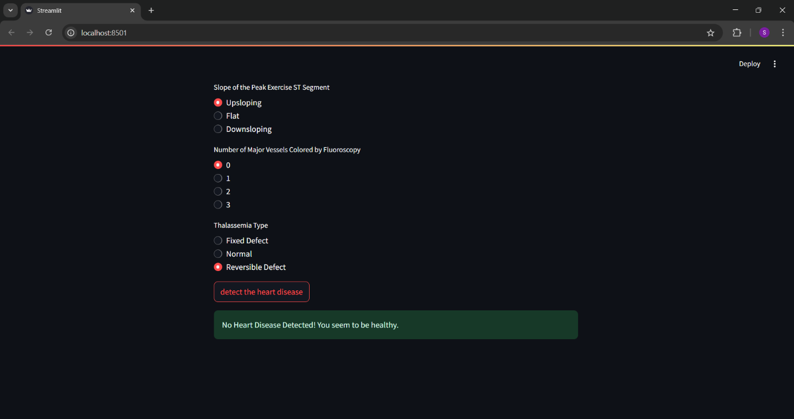
Output for a person with no heart disease

Slide 11
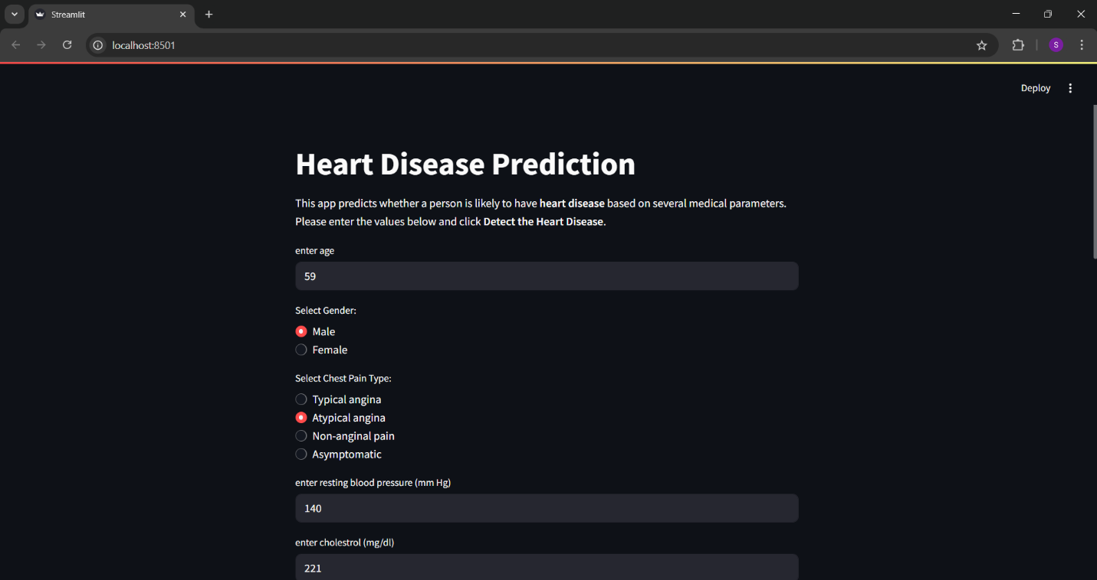
Output for a person with heart disease

Slide 12
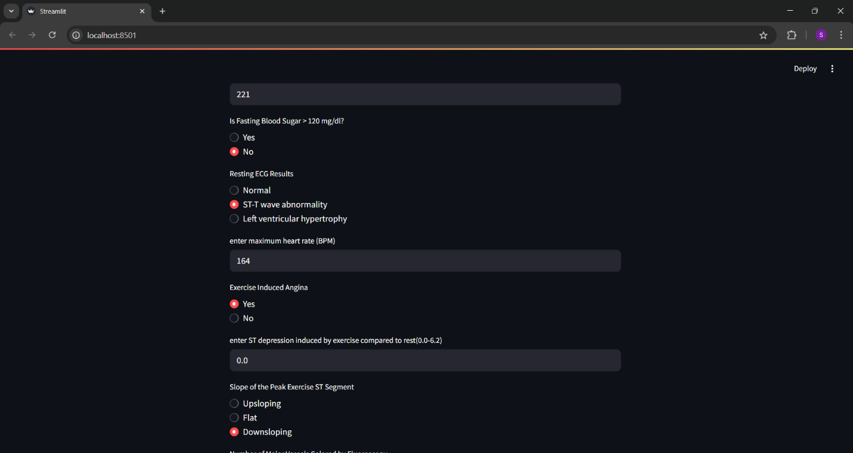
Output for a person with heart disease

Slide 13
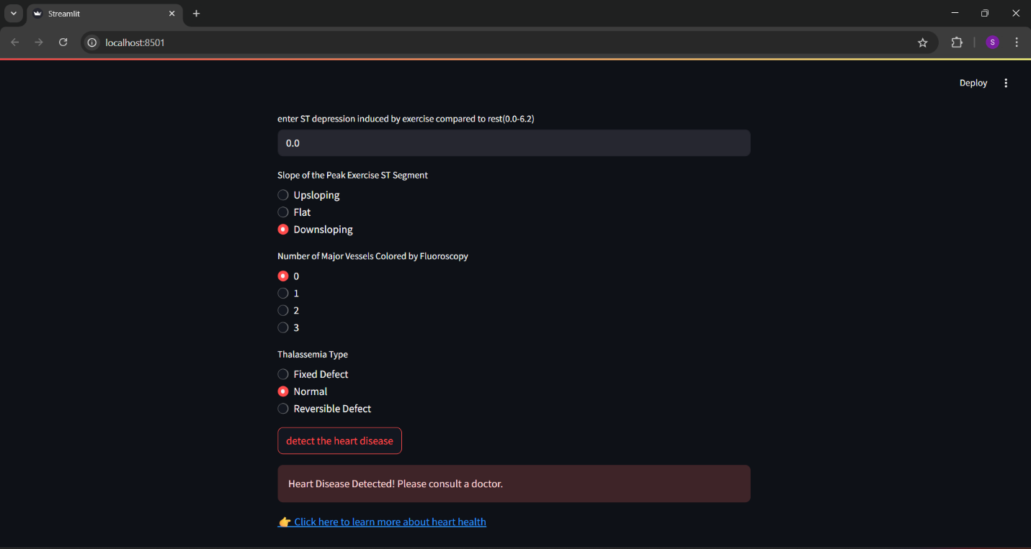
Output for a person with heart disease

Slide 14
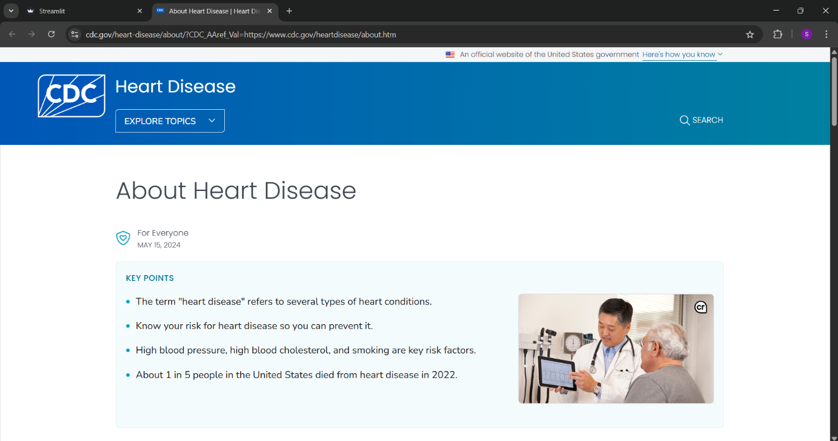
Output for a person with heart disease

Slide 15
Conclusion
The early prediction of heart disease is crucial in reducing mortality rates and enabling timely medical intervention. In this project, we developed a machine learning-based model capable of accurately identifying individuals at risk of heart disease by analyzing key health parameters such as chest pain type, cholesterol level, blood pressure, and ECG results. The model was further integrated into a user-friendly web application using Streamlit, making it easily accessible to medical professionals and patients alike. This tool not only aids in risk assessment but also demonstrates the powerful role of data science and AI in improving healthcare outcomes. Future enhancements can include the use of real-time data and integration with wearable devices to provide continuous monitoring and proactive health insights.
References
Kaggle - Heart Disease Dataset by johnsmith88 https://www.kaggle.com/datasets/johnsmith88/heart-disease-dataset
Streamlit Documentation https://docs.streamlit.io/

Slide 16
THANK YOU!!!!!

